Slide 1
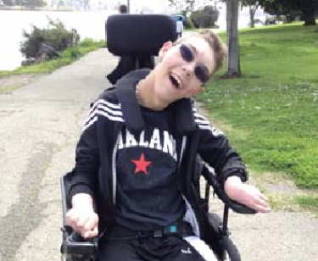

CASE STUDY
MEET: ADAM
(Pseudonym)
Picture from Google images, Retrieved 20.10.12

Slide 2

Being efficient and maintaining quality at the request for service step.
Implementing professional and legal standards step the request for service step.
“FRAMING”
Picture from google images, retrieved 20.10.12
Collaborating at request for service step
Communicating at the request for service step

Slide 3
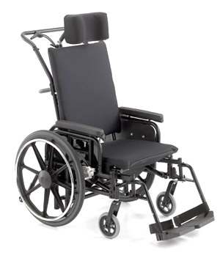
Request For service
A request for service was put in for an occupational therapist to review:
- Adam’s current seating.
Picture from Google images, retrieved 20.10.12

Slide 4

“FOCUSSING”
Being client centred at the information gathering step.
Implementing professional and legal standards at the information gathering step.
Collaborating at the information gathering step.
Communicating at the information gathering step.
Picture from google images, retrieved 20.10.12
Being efficient and maintaining a quality service at the information gathering step.

Slide 5
Being client centred at the information gathering step.
Information sought and gathered to prepare me for working with Adam:
- 15yo Boy
- Physical and intellectual disability
- Cerebral Palsy
- Dystonia in all limbs
- Uncontrolled and uncoordinated
movement.
- GMFCS IV
- Wheeled mobility – adaptive seating
- MACS level V
- Lives at home with foster mum
- Attends school 5 days a week.
(Gibson, Graham & Love, 2007)

Slide 6
Implementing professional and legal standards
Communicating with Mum
Asking consent to Adam
Communicating with teachers
Collaborating
Communicated to OT through case notes and conversations.
Collaborated with Physiotherapist
(Crepeau, Cohn & Schell, 2009)

Slide 7
Communicating:
Visual consent
Communication sheet
Maintaining quality of service:
Assessments
Communication from teachers and family

Slide 8
INFORMING:
OCCUPATIONAL ASSESSMENT
Assessments That were undertaken:
- Mat Evaluation
- Seating measurement form
- Assessment of current wheelchair
- Phone interview with mother
- Assessment of Adam’s interaction of IPAD to
determine best possible spot for mounting.
(Carden, 2009)

Slide 9
Identifying identification of occupational issues
Not enough growth in chair.
Chair has to be tilted to be able to push.
More support needed
Different positioning strategies to increase best posture for Adam.
Not able to travel in normal cars
Mount for IPAD
(Lacoste, Therrien & Prince, 2009), (Farely, Clark, Davidson, Evans, Macclennan, Michael, Morrow & Thrope, 2003), (Ryan, Snider-Riczker, & Rigby, 2005), (Costigan & Light, 2011). (Rigby, Lowe, Letts & Stewart, 2008).

Slide 10
GOAL SETTING
NAMING
Find a wheelchair with the best postural support and comfort needs for Adam within the next three months, through trialling three different companies and apply for funding.
Find the most appropriate option for IPAD mounting in the next three months and apply for funding with wheelchair.
Find alternate transportation options for Adam while on
holidays, such as mobility stroller, within the next three months and apply for
funding if required.(If wheelchair can not be folded due to loss of stability.

Slide 11
“DOING”
INTERVENTION
Maximum growth made to chair
Wheelchair Trial’s with 3 companies
Trial more wheelchair mounts
Research alternate transportation for holidays
Application to Enable for funding for wheelchair and IPAD mount.
(Rigby, Lowe, Letts & Stewart, 2008), (Crepeau, Cohn & Schell, 2009), ( Whedon, 2000)

Slide 12

“REVIEWING” Evaluation
Evaluation throughout the process
Evaluation after any prescription of equipment
Self evaluation
Picture from google images, retrieved 20.10.12

Slide 13
References:
Carden, N. (2009). Powered Mobility, Empowering Participation. Cerebral Palsy Alliance, 1-103
Costigan, A., & Light, J. (2011). Functional seating for school aged children with cerebral palsy: An Evidence Based Tutorial. Language, Speech and Hearing Services in Schools (42), 233-236
Crepeau, E., Cohn, E., & Schell, B. (2009). Willard & Spackman’s Occuaptional Therapy (Eleventh Ed.), Baltimore: Lippincott Williams and Wilkins
Farely, R., Clark, J., Davidson, C., Evans, G., Macclennan, K., Michael, S., Morrow, M., & Thrope, S. (2003). What is the evidence for effectiveness of postural management. International Journal of Therapy and Rehabilitation (10), 449-455
Gibson, N., Graham, K., & Love, S. (2007). Botulinum toxin A in the management of focal muscle overactivity in children with cerebral palsy. Disability and Rehabilitation 29(23), 1813-1822
Lacoste, M., Therrien, M., & Prince, F. (2009). Stability of cerebral palsy children in their wheelchair seating: perception of parents and therapists. Disability and Rehabilitation: Assistive Technology 4(3), 143-150
Rigby, P. Lowe, M., Letts, L., & Stewart, D. In Radomski, M. & Latham, C.(2008) Occupational Therapy for physical Dysfunction (Sixth Ed), Baltimore: Lippincott Williams and Wilkins
Ryan, S., Snider-Riczker, P., & Rigby, P. (2005). Community based performance of a pelvic stabilization device for children with spasticity. Applied Research (17), 37-46
Whedon, C. (2000). Frames of reference that address the impact of physical environments on occupational performance. Boston University, 165-174

